Slide 1


St. MARTIN’S ENGINEERING COLLEGE
UGC Autonomous
NBA & NAAC A+ ACCREDITED
Dhulapally, Secunderabad – 500 100
Department of Artificial Intelligence & Data Science (AI&DS)
E – COMMERCE DATA PIPELINE & ANALYTICS PLATFORM
Batch No: 13
1. M. Rajesh (23K81A7296)
2. K. Sree Akhil (23K81A7292)
3. Ch. Ram Mahideep Varma (23K81A7279)
Under the Guidance of
Mr. M. Rajaram
Assistant Professor
Department of Artificial Intelligence & Data Science (AI&DS)

Slide 2
OUTLINE
Abstract
Existing System
Architectural Design For Proposed System
ER Diagram / Flow Diagram / Use Case Diagram
Algorithms Used With Complexity
Expected Outcomes
References
30% Code Implementation

Slide 3
ABSTRACT
The E – Commerce Data Pipeline & Analytics Platform is a data – driven system designed to collect, process, store, analyse, and visualize e – commerce business data to support better decision – making and business intelligence. In modern e – commerce environments, organizations generate large volumes of data through customer interactions, product sales, payments, orders, and reviews. Managing and extracting meaningful insights from this data manually becomes inefficient and time – consuming. Data is collected from multiple sources such as CSV files and databases containing information related to customers, products, transactions, orders, and payment details. During the extraction phase, data is gathered from these sources and prepared for processing. In the transformation phase, the system performs data cleaning, handling missing values, removing duplicate records, standardizing formats, and generating calculated business metrics. Finally, the processed data is loaded into a structured database for efficient storage and retrieval.
KEYWORDS: E-Commerce Analytics, Data Pipeline, ETL, Business Intelligence, Data Visualization, Power BI, Streamlit, SQL, Python, Predictive Analytics, Data Engineering.

Slide 4
EXISTING SYSTEM
In existing approach, the e – commerce data is collected from different fields such as customer records, customer reviews, products, orders, payments, and sellers. These data sources may be maintained separately in CSV files, spreadsheets, application databases, or different business systems. And to perform analysis, the data often needs to be manually collected, cleaned, combined, and prepared before it can be used.
Data analysts may use tools such as Excel, Python, SQL, or separate business intelligence applications to generate reports and dashboards. The cleaning, transformation, analysis, and visualization activities may be performed as separate processes rather than as a single integrated pipeline.
CHALLENGES IN THE EXISTING SYSTEM:
Data Fragmentation (Data is stored in different sources)
Manual Data Processing (manually collected, cleaned, and combined before analysis)
Data – Quality Issues (Missing, duplicate, inconsistent, or invalid data may affect analysis)
⁠Limited Automation (Data refresh and processing may require manual execution)
⁠Limited Predictive Capability (Traditional reporting mainly explains historical performance rather than future trends)

Slide 5
PROPOSED SYSTEM
The developing system for E – Commerce Data Pipeline & Analytics Platform is an interactive web – based analytics system designed to automate the complete journey of e – commerce data from raw input to business insights. The system accepts e – commerce data from multiple structured sources such as customer, product, order, order – item, payment, seller, and review datasets.
A Python – Based ETL (Extract, Transform, Load) pipeline extracts the raw data, cleans and transforms it and performs data – quality validation, and loads the processed data into a centralized PostgreSQL database.
A Streamlit – Based Web Platform provides an interactive interface through which users can access dashboards and analytics.
Further Machine – Learning Sales Forecasting Module can be used for historical sales data to predict future sales and trends. Also, AI Agent can be proposed for web platform for easy and user – friendly environment.
ADVANTAGES OF THE PROPOSED SYSTEM:
Centralized Data Management (PostgreSQL)
Improved Data Quality (handles missing values, duplicates, inconsistent formats, and invalid records before analysis)
Interactive Dashboard (an interactive Streamlit – based interface) / Power BI
Predictive Analytics (machine – learning techniques)

Slide 6
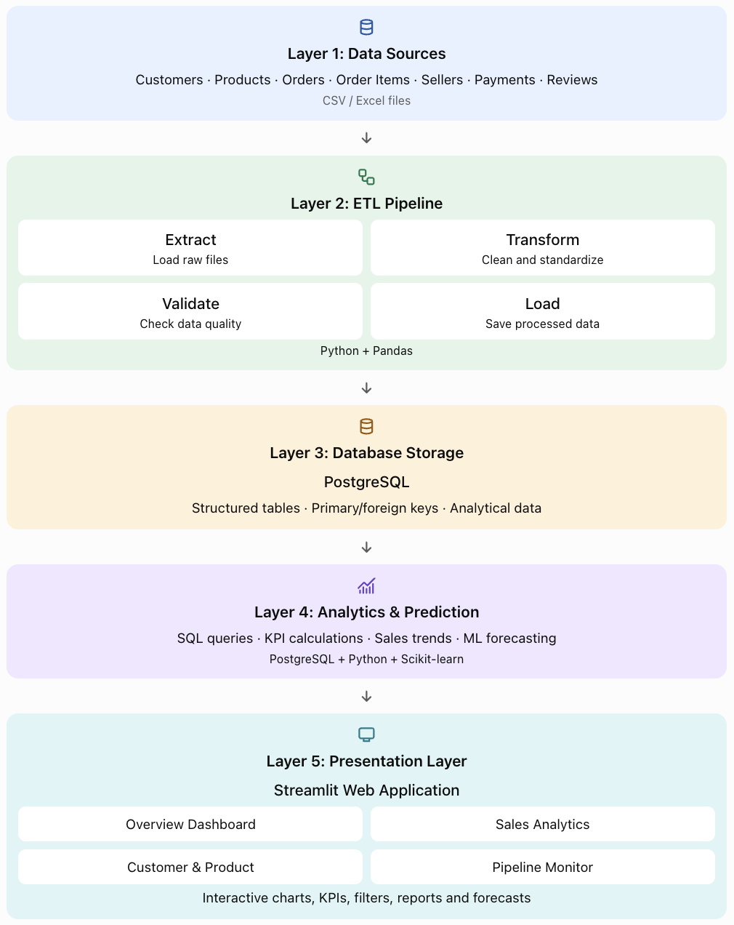
ARCHITECTURAL DESIGN FOR PROPOSED SYSTEM

Slide 7
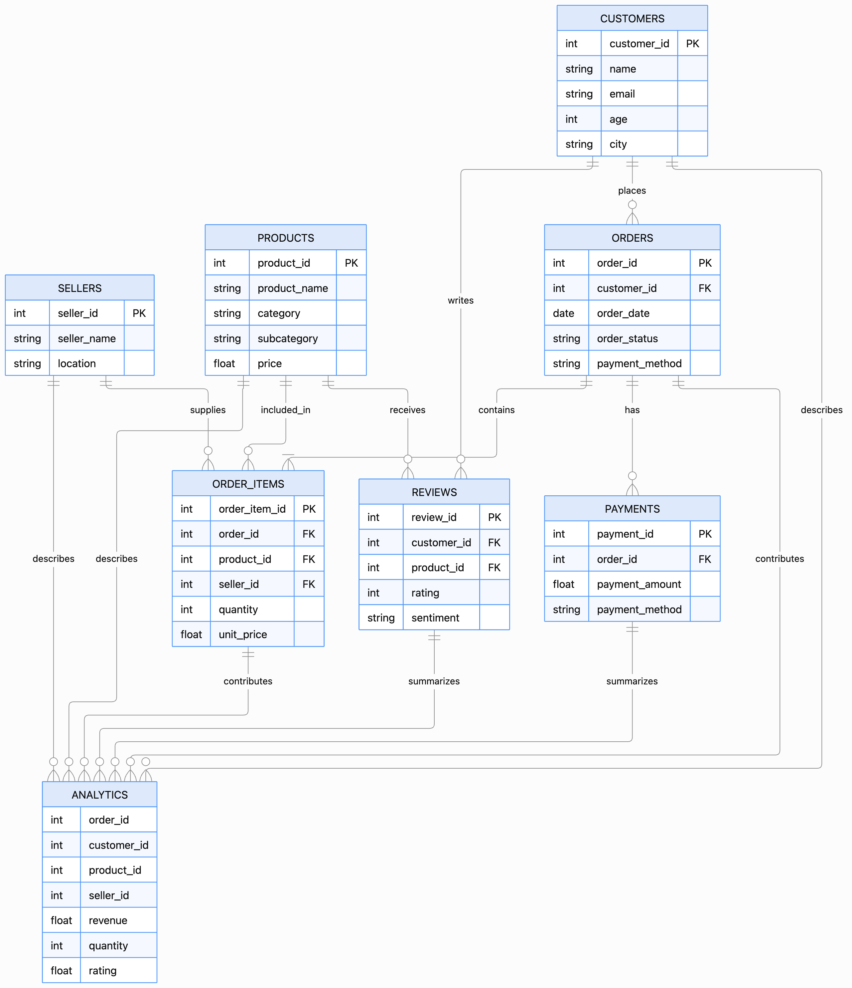
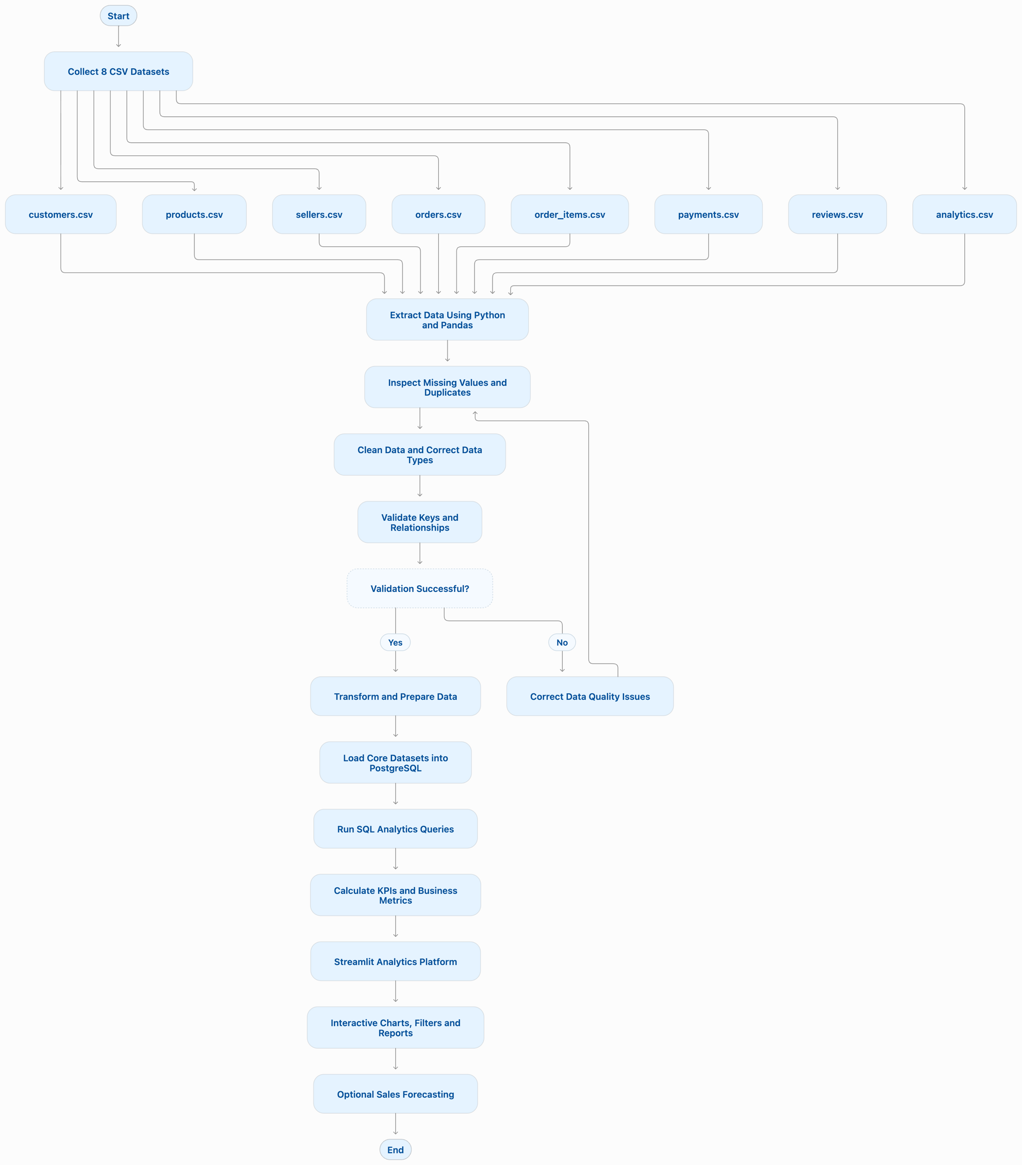
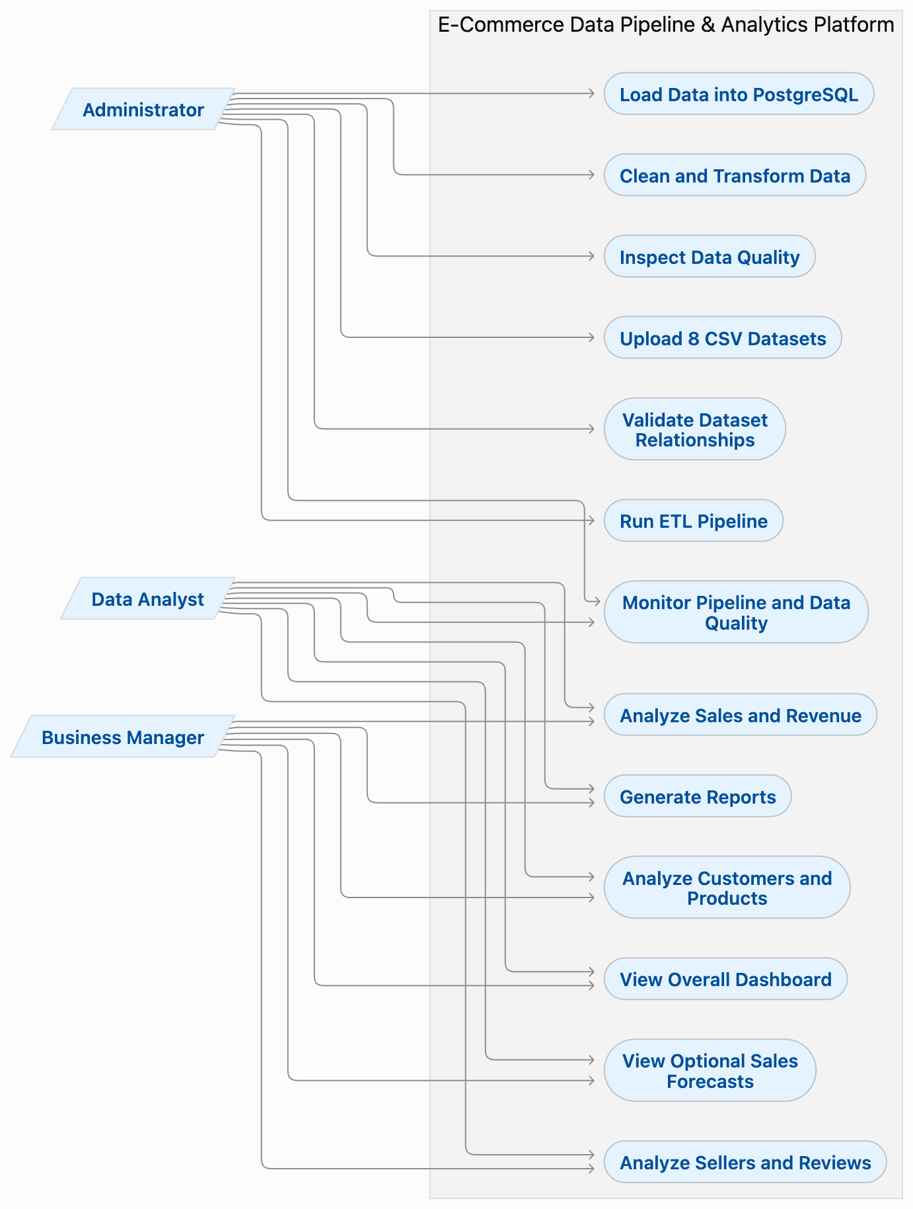
ER DIAGRAM / FLOW DIAGRAM / USE CASE DIAGRAM
ER DIAGRAM
FLOW DIAGRAM
USE CASE DIAGRAM

Slide 8
ALGORITHMS USED WITH COMPLEXITY
ALGORITHM | TIME COMPLEXITY | SPACE COMPLEXITY
DATA CLEANING ALGORITHM | O (NC) | O (NC)
DATA VALIDATION ALGORITHM | O (NC) | O (NC)
DATA INTEGRATION ALGORITHM | O (N + M) Average | O (N + M)
ETL ALGORITHM | O (NC) | O (NC)
DATA AGGREGATION ALGORITHM | O (N) Average | O (G)
N = Number Of Records In The Primary Dataset
C = Number Of Columns
M = Number Of Records In The Second Dataset Being Joined
G = Number Of Groups Produced By Aggregation, Such As Product Categories
Estimated Values:
N = 2857
C = 21
M = 44
G = After Implementing The ETL Workflow

Slide 9
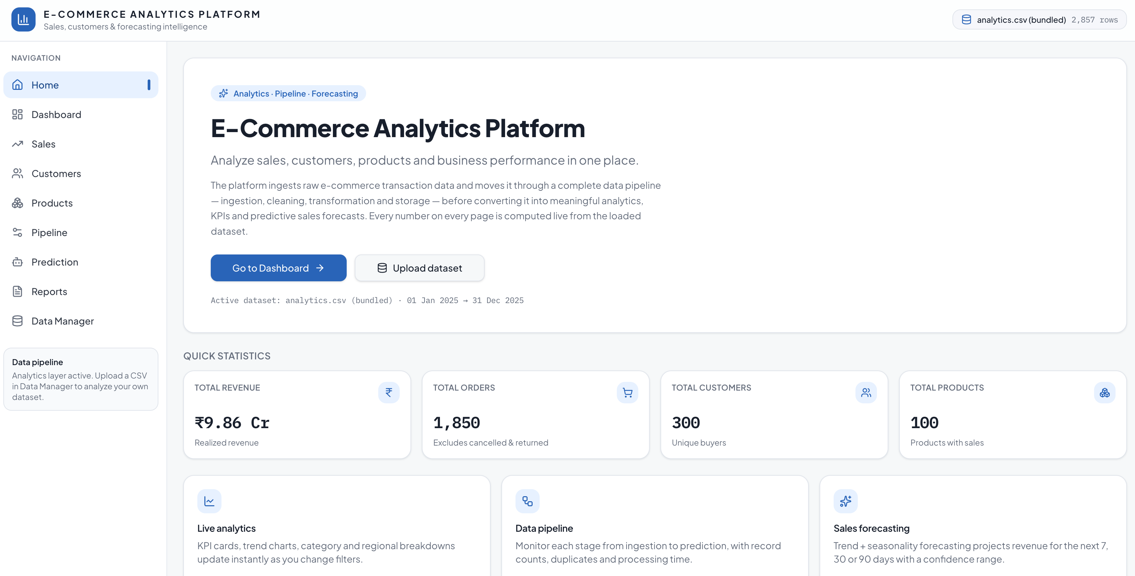
EXPECTED OUTCOMES

Slide 10
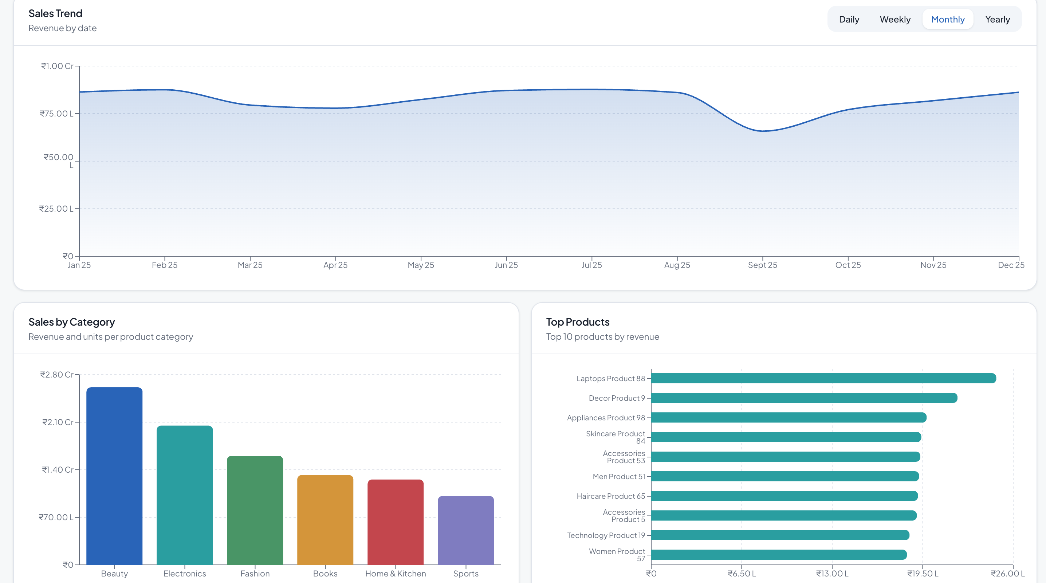
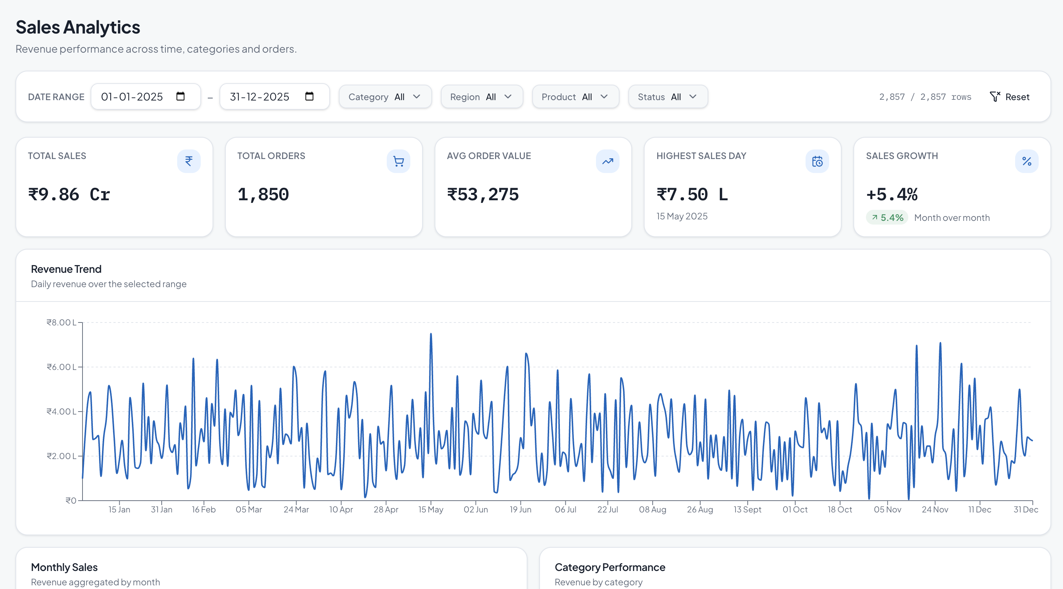

Slide 11
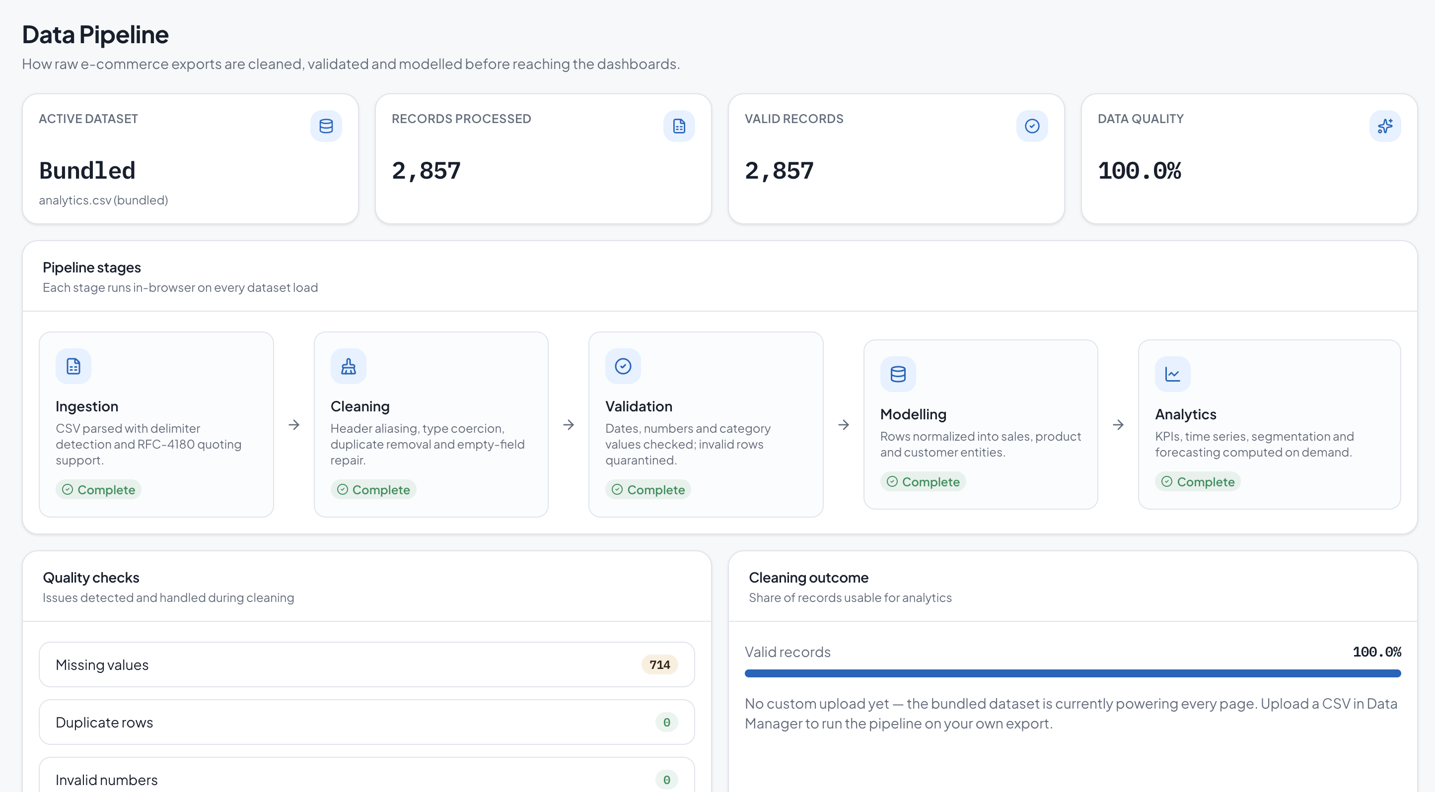
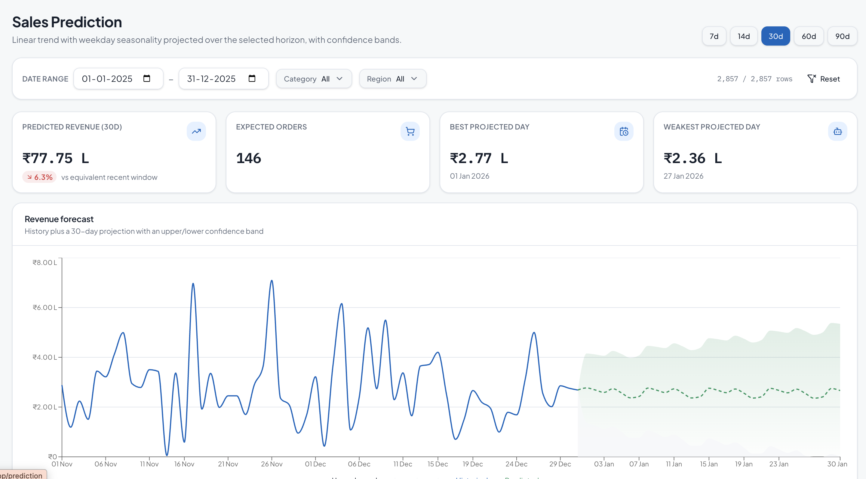

Slide 12
REFERENCES
M. K. Mahesha, S. B. Sagar, T. Tejonidhi, Y. N. Yashwanth, and A. V., “A review on real-time data pipelines for e-commerce transactional data analytics,” EPRA International Journal of Research & Development, vol. 10, no. 8, Aug. 2025.
L. M. Policarpo, D. E. da Silveira, R. da Rosa Righi, R. A. Stoffel, C. A. da Costa, J. L. V. Barbosa, R. Scorsatto, and T. Arcot, “Machine learning through the lens of e-commerce initiatives: An up-to-date systematic literature review,” Computer Science Review, vol. 41, art. no. 100414, Aug. 2021.
Gamboa-Cruzado, T. Mosqueira-Cerda, A. Torre Camones, R. Quispe Mendoza, A. F. Navarro Raymundo, J. Jiménez García, and B. C. López-Ramírez, “Exploring the influence of machine learning in e-Commerce: A systematic and bibliometric review,” Computación y Sistemas, vol. 29, no. 2, pp. 925–953, 2025.
X. Hu, “A data warehouse/online analytic processing framework for web usage mining and business intelligence reporting,” International Journal of Intelligent Systems, vol. 19, no. 7, pp. 585–606, 2004.
M. N. Prakoso and Nuryuliani, “Application development of e-commerce business intelligence dashboard,” International Journal of Computer Sciences and Engineering, vol. 7, no. 8, 2019.
P. Hutabalian, “Implementasi Pipeline ETL/ELT dan Model Dimensional untuk Analisis Penjualan Shopee Menggunakan PostgreSQL, Docker, dan Apache Superset,” Jurnal Informatika dan Teknik Elektro Terapan, vol. 13, no. 3S1, 2025.

Slide 13
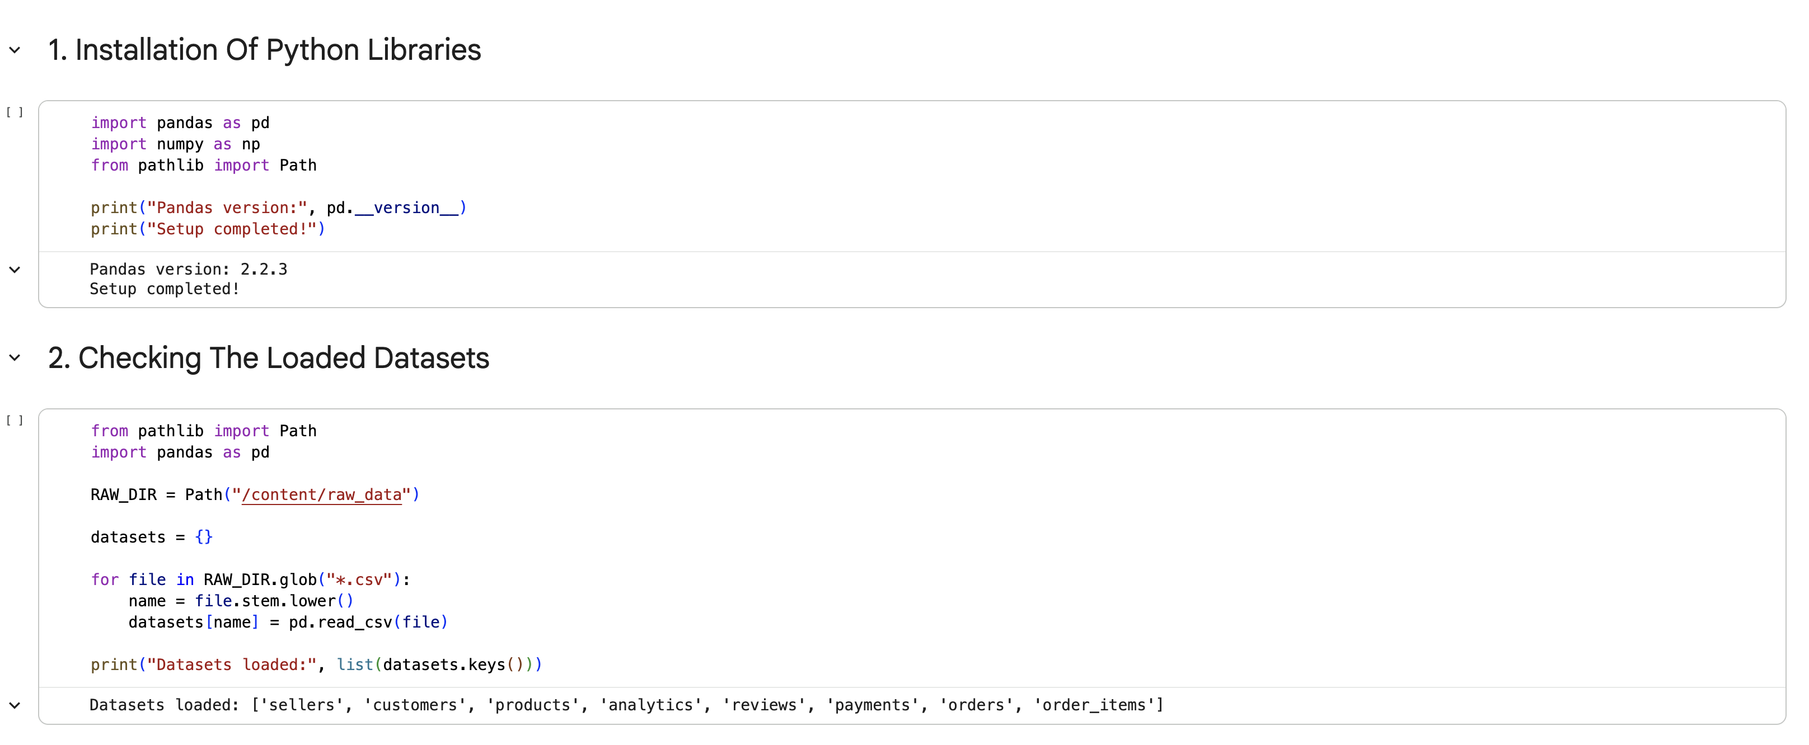
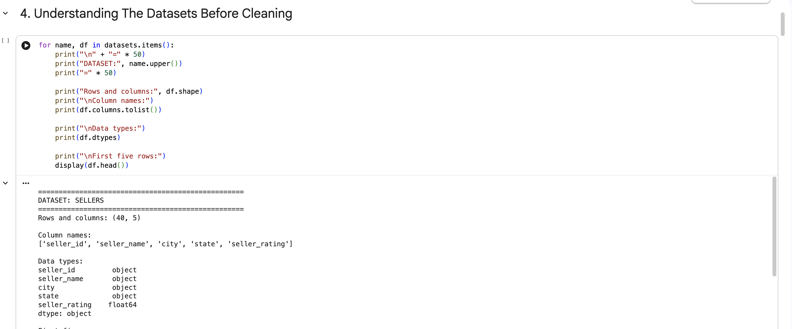
30% CODE IMPLEMENTATION

Slide 14
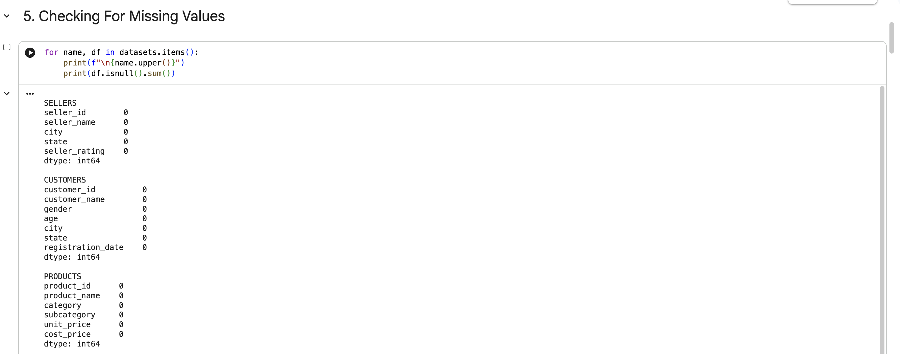
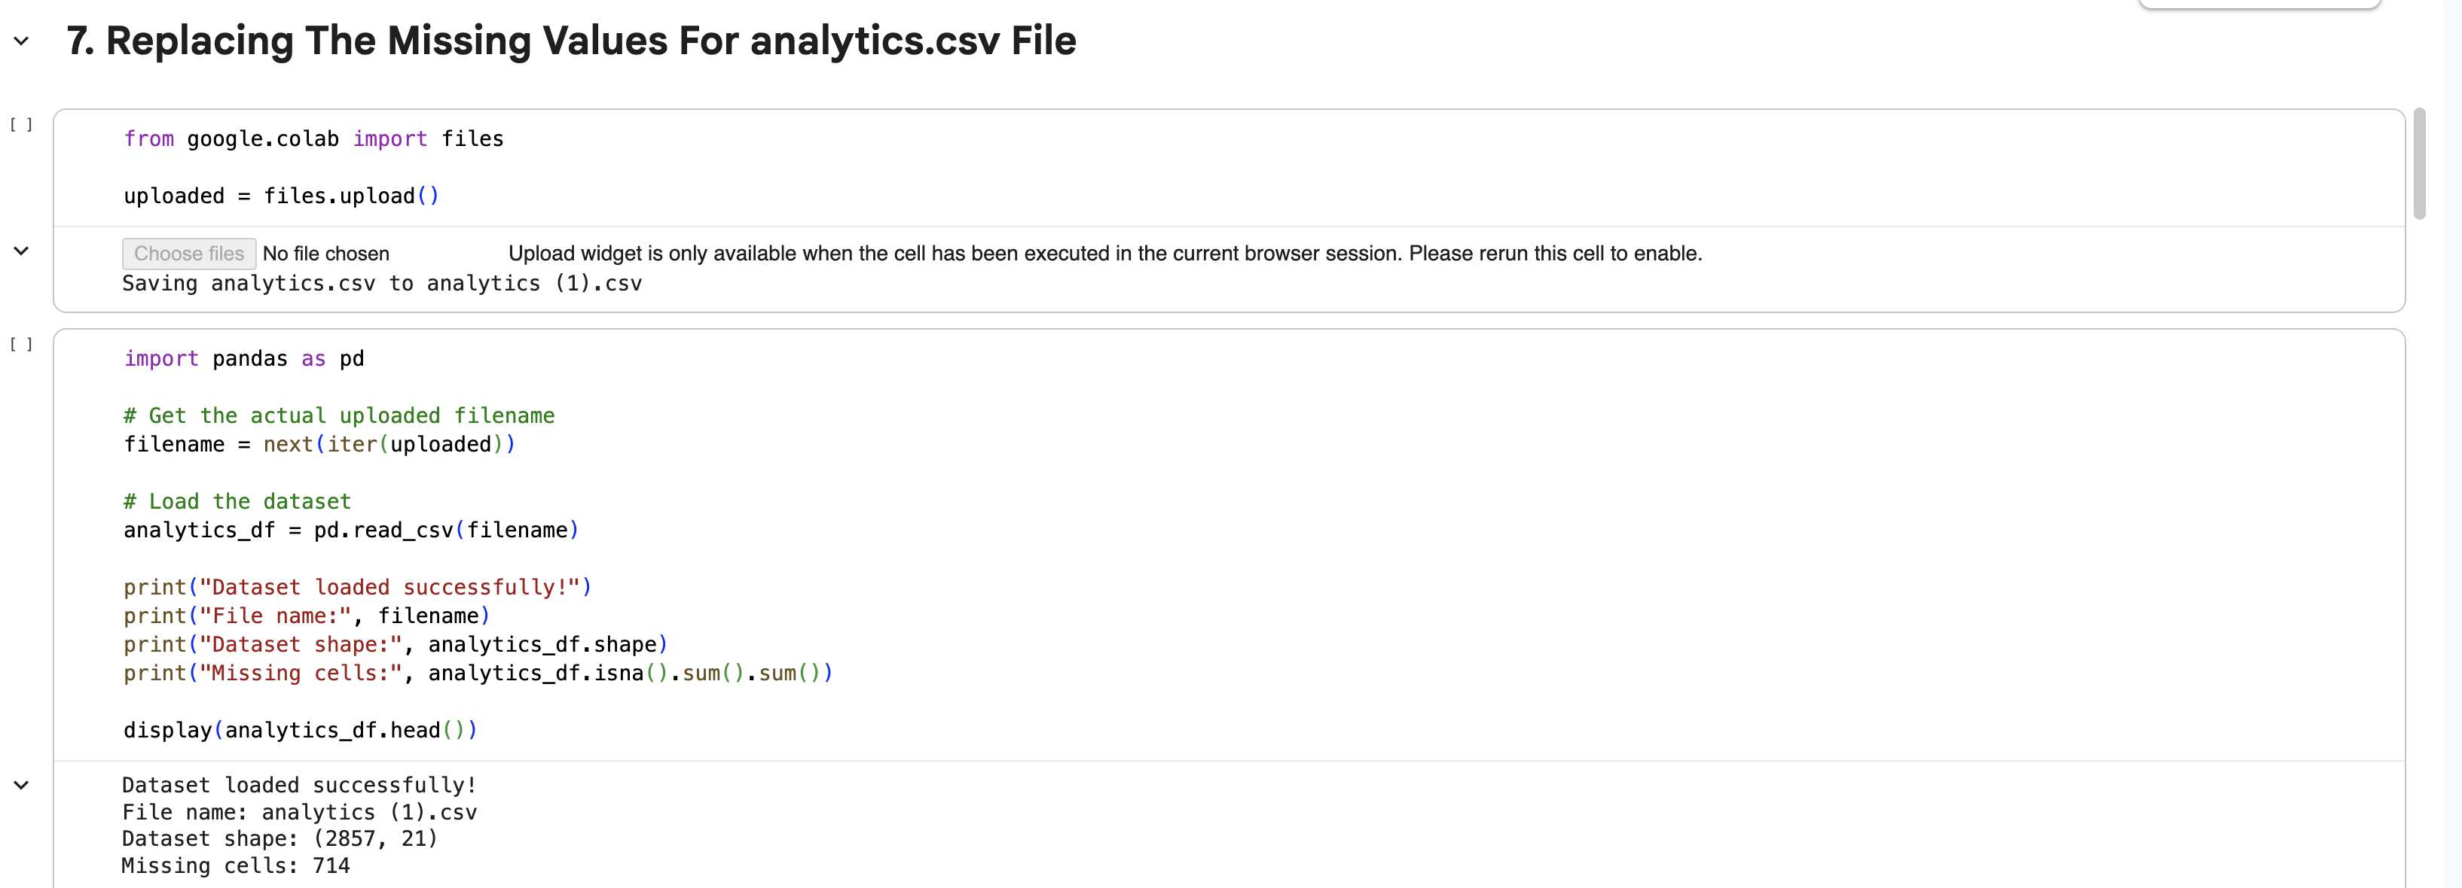

Slide 15
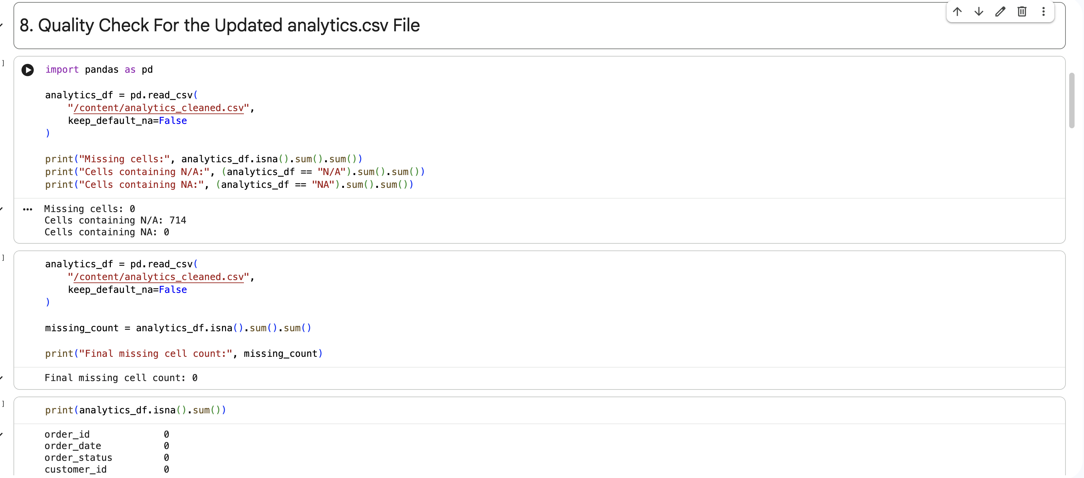
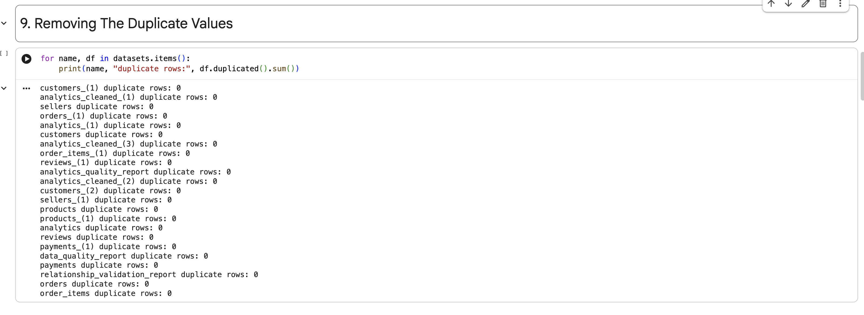

Slide 16
THANK YOU !!

